Slide 1
Jessica Lindvall
Head of Training, SciLifeLab Training Hub, Sweden Associate Professor, Stockholm University, Sweden
Notes:
Presentation from the plenary session at the conference BioSB, which is the 9th edition of the Dutch Bioinformatics & Systems Biology conference held on 9 and 10 May 2023.
I was invited to give the plenary session on the 9th of May and to take part in the discussions around a national, Dutch, educational framework for Bioinformatics and Systems Biology (primarily aimed at MSc students/programmes). This framework is in tandem with a European framework for Bioinformatics that has been independently formulated from the ISCB (see here).

Slide 2
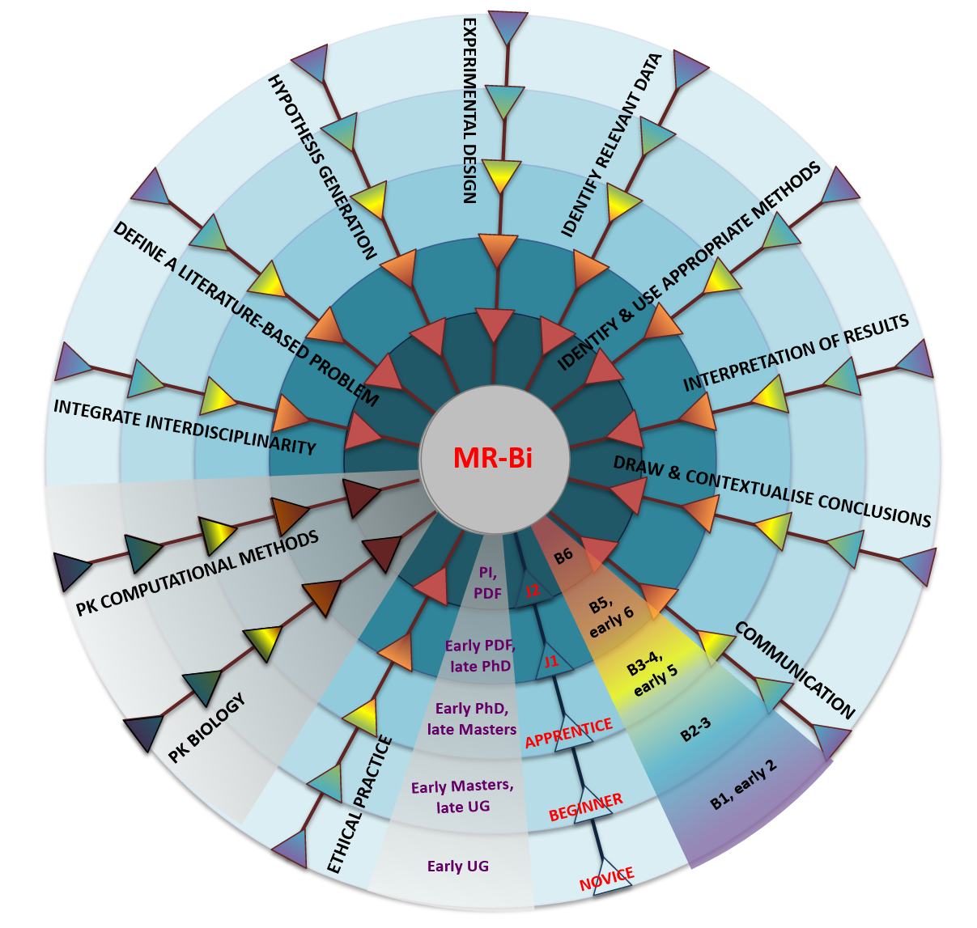
Conceptualising the Mastery Rubric for Bioinformatics
a framework for curricula design
Notes:
The presentation bears the title of “Conceptualising the Mastery Rubric for Bioinformatics - a framework for curricula design” and is a collaborative work spanning many years and different work.

Slide 3
Resources
the presentation builds on
MR-Bi paper, PLoS ONE: https://doi.org/10.1371/journal.pone.0225256
Curriculum Guidelines, SocArXiv: https://osf.io/preprints/socarxiv/7qeht/
Curriculum Guidelines, F1000R: https://doi.org/10.7490/f1000research.1118395.1
Introducing the MR-Bi, F1000: https://doi.org/10.7490/f1000research.1119019.1
Using the MR-Bi, F1000R: https://doi.org/10.7490/f1000research.1119023.1
MR-Bi slides - training and professional development: https://doi.org/10.17044/scilifelab.16715374.v1
Notes:
The presentation are built from the resources listed on the slide. The slide will appear again in the end of the presentation.

Slide 4
WHAT IS THE MR-BI?
Notes:
I will first take you to a tour across the framework itself, what is the Mastery Rubric for Bioinformatics?

Slide 5
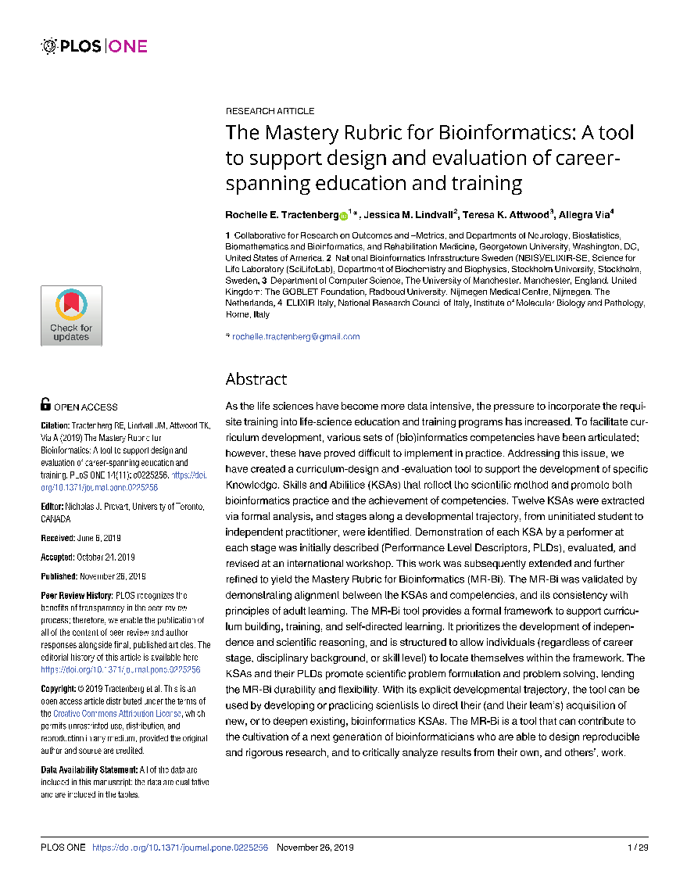
https://doi.org/10.1371/journal.pone.0225256
Notes:
You can find out all the details of the tool in the paper we published at the end of 2019 in PLoS One: The Mastery Rubric for Bioinformatics: a tool to support design & evaluation of career-spanning education & training.
The DOI is at the bottom, here - for anyone who’s interested, this URL appears again in the final slide, as do all other URLs mentioned in later slides – so you don’t need to write them down now.

Slide 6
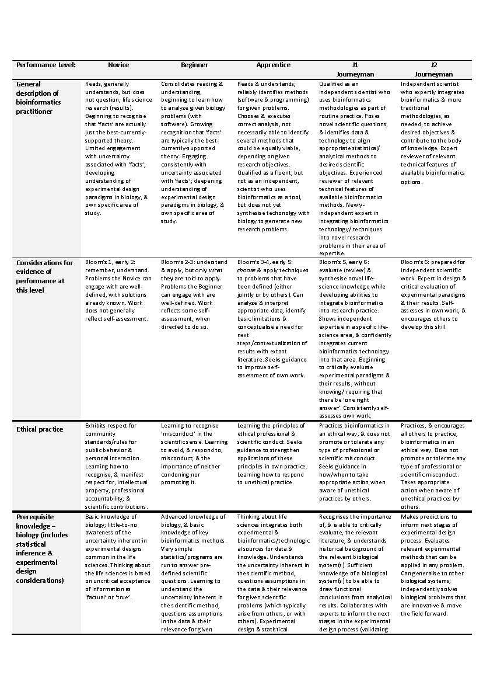
A descriptive ‘3D’ table
KSAs, Stages, PLDs
Notes:
For those who’ve read the paper, you’ll already have discovered Table 1. Table 1 is the MR-Bi, essentially a descriptive table with 3 ‘dimensions’:
* the y-axis lists the Knowledge Skills & Abilities (the KSAs) that are intended to be delivered by a course or programme;
* the x-axis outlines a developmental trajectory from less to more expert – i.e., from novice to (independent) journeyman;
* & the individual cells (like the one shown) describe in detail how a learner might be expected to perform, & thence to change over time, when progressing along that trajectory (these are the so-called Performance Level Descriptors, or PLDs). As you can see, at first glance, there’s quite a lot to take in…

Slide 7
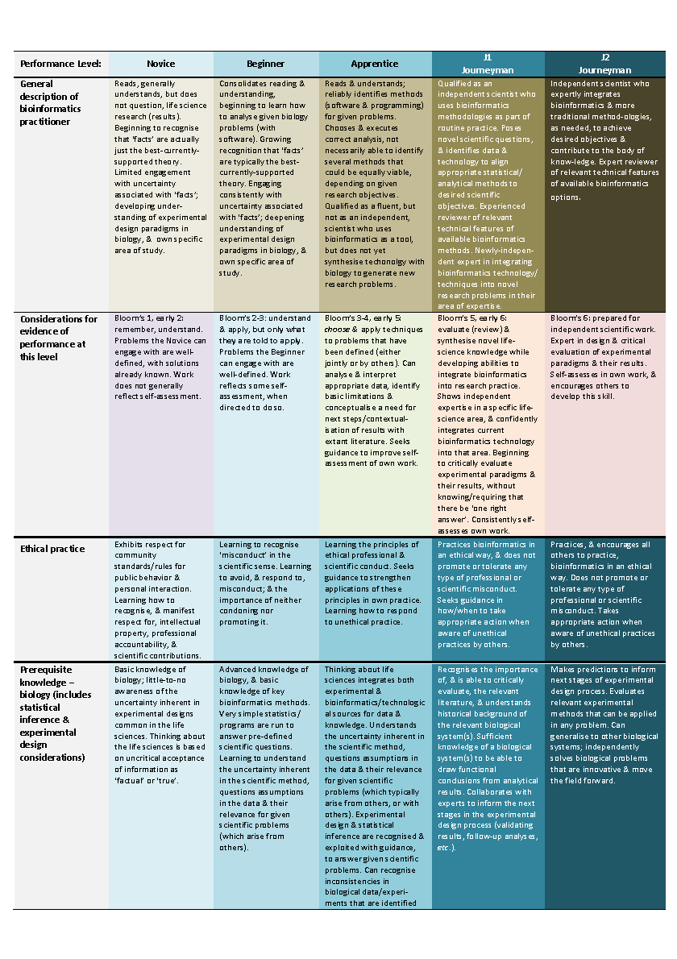
A descriptive ‘3D’ table
KSAs, Stages, PLDs
Notes:
So, to help navigate through the table, or to better orientate ourselves, we can highlight its main features (this is exactly the same thing, but just coloured in).
* At the top, there’s a general description of an individual at a given stage (I should say that you’re not meant to be able to read this – this is just for you to note that there is a progression as an individual advances from novice to journeyman).
* Alongside this are the requisite stages of Bloom’s hierarchy of cognitive complexity as it builds from lower- to higher-order ‘critical’ thinking skills (Blooms level 1 to Blooms level 6).
* Then, beneath these are the 12 KSAs & the corresponding PLDs for each stage. But this is just the first page of the table…
* As you can see, it’s actually massive…

Slide 8
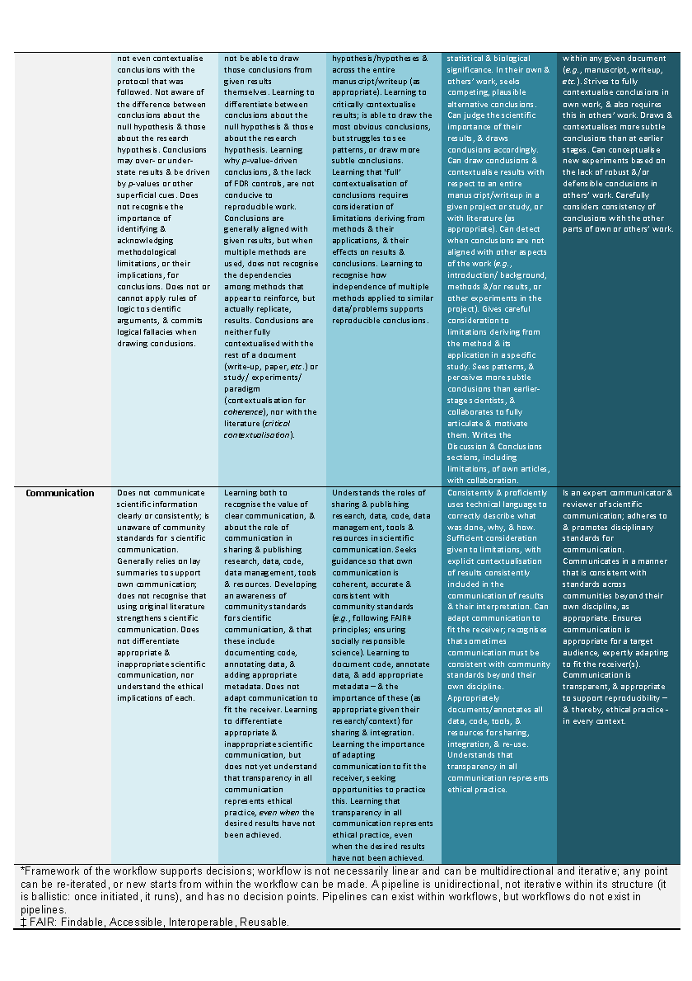
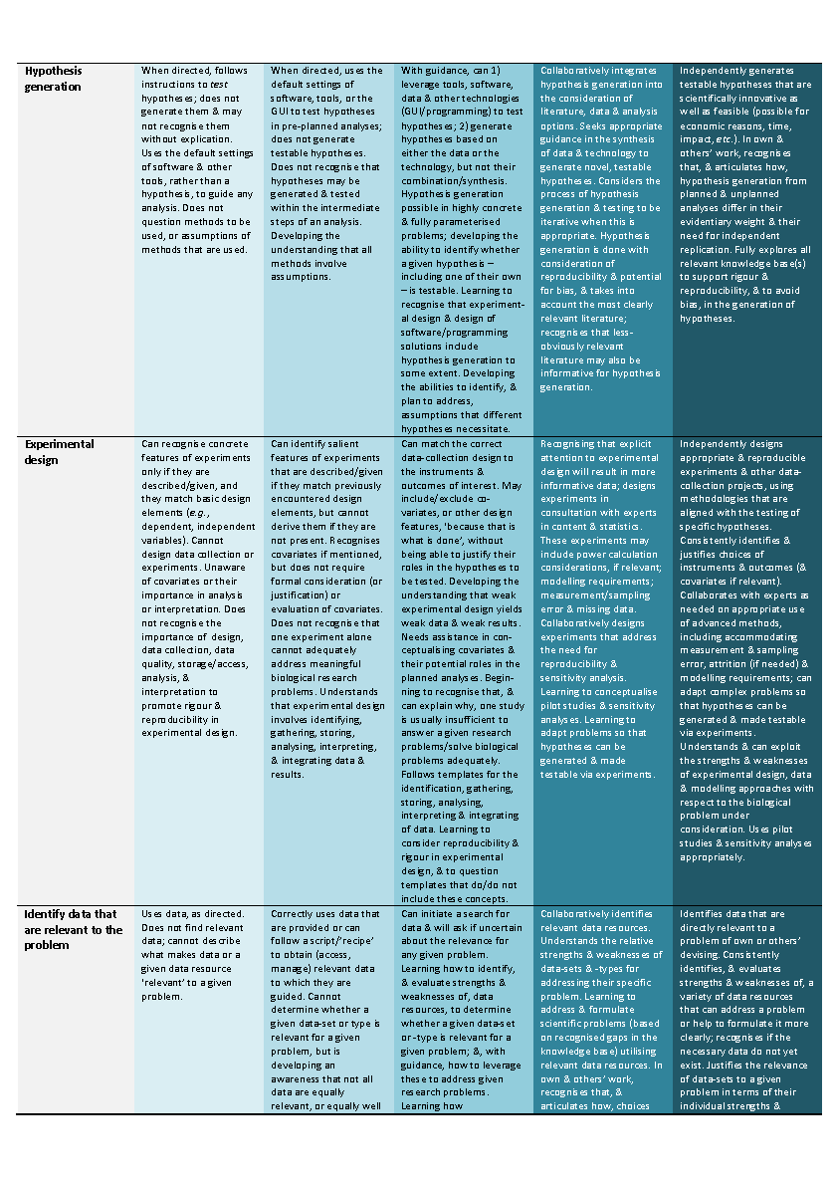
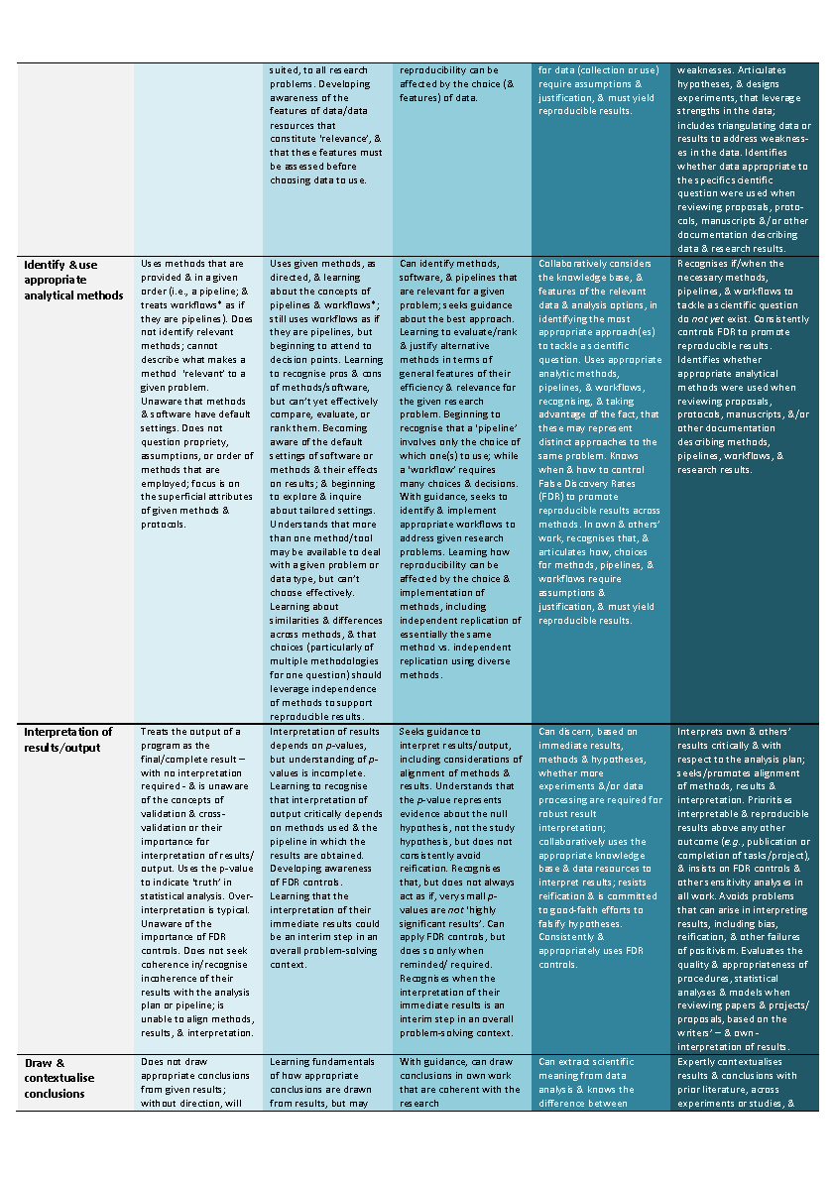
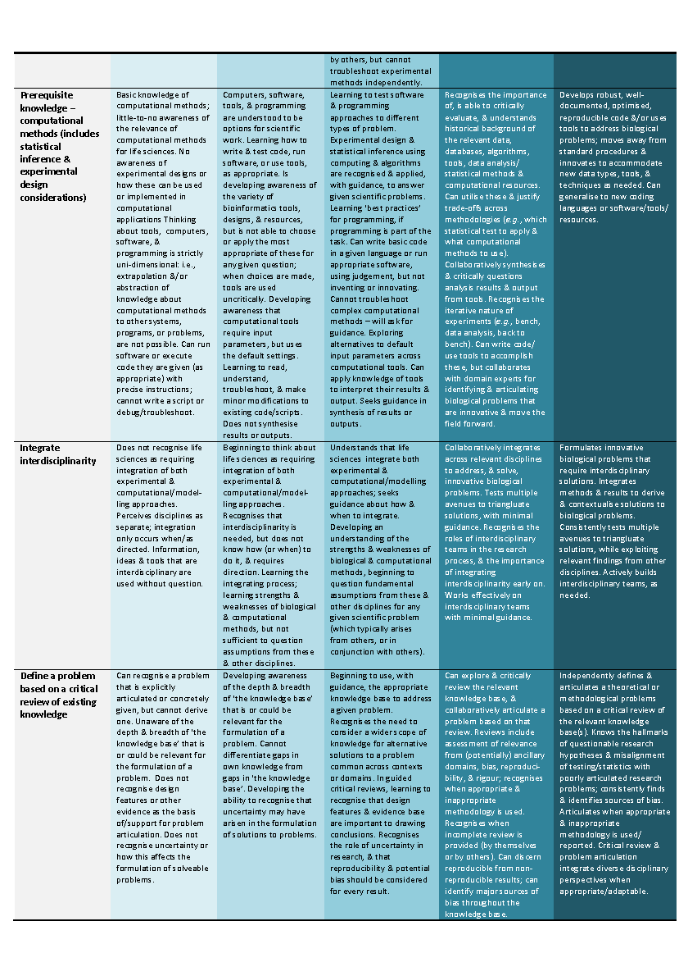
A descriptive ‘3D’ table
KSAs, Stages, PLDs
Notes:
…covering a total of 6 pages!
* Clearly, this isn’t the easiest thing to digest! But we can summarise the whole thing in a much simpler table…

Slide 9
KSA | Novice | Beginner | Apprentice | J1 Journeyman | J2 Journeyman
PK biology | Basic knowledge of biology | Advanced knowledge of biology & basic knowledge of bioinformatics methods | Integrates experimental & bioinformatics sources for data & knowledge | Sufficient knowledge of biological systems to be able to draw functional conclusions from results | Independently solves biological problems that are innovative & move the field forward
PK computational methods | Basic knowledge of computational methods
Integrate interdisciplinarity | Doesn’t recognise that life sciences require integration of experimental & computational approaches
Define a literature-based problem | Can recognise a problem that is explicitly articulated but can’t derive one
Hypothesis generation | Doesn’t generate hypotheses & may not recognise them without explanation
Experimental design | Can’t design data collection or experiments
Identify relevant data | Can’t describe what makes data relevant to a problem
Identify & use appropriate methods | Doesn’t identify methods relevant to a problem
Interpretation of results | Treats the output of pro-grams as the final result, without interpretation
Draw & contextualise conclusions | Doesn’t draw appropriate conclusions from results
Communication | Doesn’t communicate scientific results clearly or consistently
Ethical practice | Learning how to recognise intellectual property & scientific contributions
Stages (columns)
Developmental trajectory, from less (novice) to more expert (journeyman)
Knowledge, Skills & Abilities (KSAs) (rows)
Performance Level Descriptors (PLDs)
(cells) Describe performance at each stage
Notes:
…which looks like this
* Again, note the 12 KSAs on the y-axis, one on each row. I should point out that these are not to be confused with the KSAs encapsulated in various competency frameworks – the KSAs referred to here are much broader or higher-level concepts.
* As before, the stages are along the x-axis, denoting in each column a particular point in the developmental trajectory, from less to more expert.
* & the descriptions of learner performance (the PLDs) at those levels are given in each cell.
* So the key take-homes here are the KSAs, the stages & the PLDs.

Slide 10
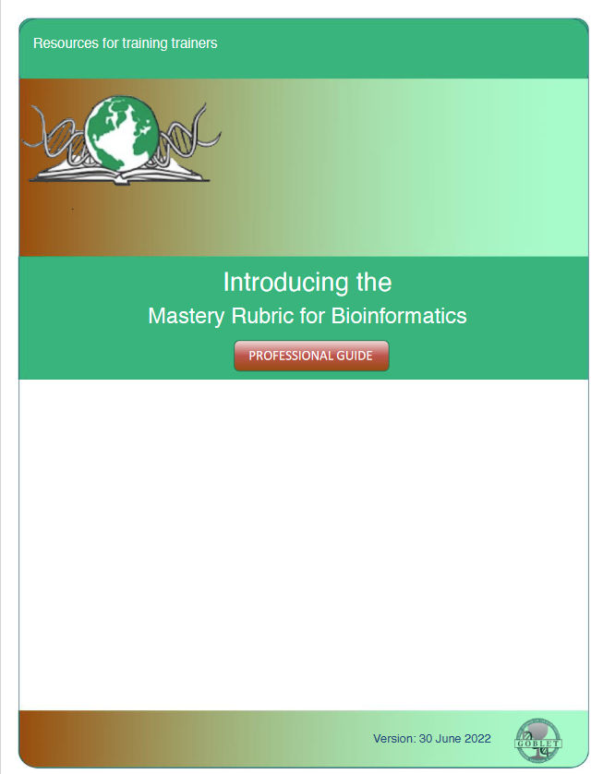
https://doi.org/10.7490/f1000research.1119019.1
https://doi.org/10.7490/f1000research.1119023.1
Notes:
In addition to the original paper in PLoS One we have written 2 papers for the ELIXIR-GOBLET Professional Guidelines collection (the F1000R Bioinformatics Education & Training Collection) outlining the usage of the framework in a more “hands-on” and practical manner
introduces the Master Rubric for Bioinformatics as a framework, and the
show you “how to use” the Mastery Rubric for Bioinformatics framework
This presentation outlines these two guides.

Slide 11
A VISUAL TOUR
Notes:
It’s a big ask to expect anyone to take all of this in in one go, so we’re now going to look at the MR-Bi from a slightly different perspective – hopefully, this will help you to mentally unpack its components, & better show how they work together…
It’s important to stress at this point that the key thing here is the concepts, not the nitty-gritty detail…
But again, please shout if anything’s unclear

Slide 12
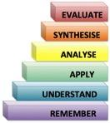
European Guild Structure
Apprentice, Journeyman, Master
EXPERIMENTAL DESIGN
IDENTIFY RELEVANT DATA
HYPOTHESIS GENERATION
KSAs based on the scientific-method
IDENTIFY & USE APPROPRIATE METHODS
DEFINE A LITERATURE-BASED PROBLEM
INTERPRETATION OF RESULTS
INTEGRATE INTERDISCIPLINARITY
MASTER
DRAW & CONTEXTUALISE CONCLUSIONS
B6
PK COMPUTATIONAL METHODS
PI, PDF
B5, early 6
J2
Early PDF,
late PhD
Higher-order ‘critical’ thinking skills
Foundational discipline-specific KSAs
J1
B3-4, early 5
COMMUNICATION
Early PhD, late Masters
PK BIOLOGY
APPRENTICE
B2-3
B6
B5
ETHICAL PRACTICE
Early Masters, late UG
B1, early 2
B4
BEGINNER
B3
Early UG
B2
Ethics
NOVICE
B1
Lower-order thinking skills
Notes:
The first thing to note is that the Mastery Rubric builds on the (ancient) European Guild Structure, which outlines a trajectory from Apprentice through Journeyman to what was originally Master Craftsman or Tradesman.
* But the MR adds two further stages – Novice, Beginner.
* It also differentiates the Journeyman stage into early & late (J1 & J2) stages, recognising that the Journeyman period is generally the longest phase of ‘training’– there are hence observable differences between a newly qualified individual (a new PhD) & one with, say, 10 or more years of experience (say an independent research fellow or PI)...who has arguably achieved mastery of his/her subject.
* Each of these stages can be mapped to the relevant Bloom’s level – from remember/understand (B1,B2) through apply/analyse (B3,B4) to synthesise & evaluate (B5 & B6).
* Similarly, each stage can be mapped to stages in a traditional academic trajectory, from UG through Masters, to PhD & PDF, & ultimately independent PI.
* As shown earlier, the MR lists the KSAs a programme is intended to deliver: for bioinformatics, these are based on foundational, discipline-specific KSAs – PK Biology & PK Computational Methods
* Then 9 further KSAs based on the scientific method;
* & last, but not least, ethical practice.
Hopefully, this is beginning to give you a feel for how each of the stages builds, layer upon layer, onto the next in terms of cognitive complexity (advancing Blooms) as an individual progresses from less to more expert, from Novice (outside layer) to Independent scientist (inside layer). We can now take a closer look at this, layer by layer.

Slide 13
Performance-level descriptors
Novice
EXPERIMENTAL DESIGN
HYPOTHESIS GENERATION
IDENTIFY RELEVANT DATA
Can recognise concrete features of experiments only if they are described/given, and they match basic design elements (e.g., dependent, independent variables). Can‘t design data collection...
Uses data, as directed. Does not find relevant data; cannot describe what makes data or a given data resource relevant to a given problem.
Uses methods that are provided & in a given order (i.e., a pipeline, & treats workflows as if they x............... are pipelines). Doesn‘t identify relevant x......... methods; can‘t describe what x . . .. makes a method relevant...
When directed, follows instructions to test hypotheses; does not generate them & may not recognise them without explication. Uses the default settings of software & other tools ...
IDENTIFY & USE APPROPRIATE METHODS
DEFINE A LITERATURE-BASED PROBLEM
Treats the output of a program as the final result – with no interpretation required - & is unaware of the concepts of validation & cross- validation or their importance x for interpretation of results...
Can recognise a problem that is explicitly articulated or concretely given, but cannot derive one. Unaware of the depth & breadth of the
Knowledge-base that is or could be relevant for the...
INTERPRETATION OF RESULTS
INTEGRATE INTERDISCIPLINARITY
Does not draw appropriate conclusions from given results; without direction, will not even x contextualise conclusions with the x protocol that was followed. Not x aware of the difference between...
Does not recognise life sciences as requiring integration of experimental & computational/modelling approaches. Perceives disciplines as separate; integration only occurs when/as...
DRAW & CONTEXTUALISE CONCLUSIONS
PK COMPUTATIONAL METHODS
Does not communicate scientific information clearly or consistently; is unaware of community standards for scientific communication. X Generally relies on lay summaries to support own...
Basic knowledge of computational methods; little-to-no awareness of the relevance of computational methods for life sciences. No awareness
of experimental designs or how these can be...
Basic knowledge of biology; little-to-no awareness of the uncertainty inherent in experimental designs common in the life sciences. Thinking about the life sciences is based on uncritical acceptance...
Reads, generally understands, but doesn‘t question, research results. Beginning to recognise that ‘facts‘ are just the best current theory...
Exhibits respect for community standards/rules for public behavior & personal interaction. Learning how to recognise, & manifest respect for, IP, professional accountability & scientific contributions.
COMMUNICATION
PK BIOLOGY
Remember, understand
ETHICAL PRACTICE
Early undergraduate
PLDs describe what it should look like as learners develop from less to more expert demonstration of each KSA
NOVICE
Notes:
Hidden within each of the layers, at each level, are the Performance Level Descriptors (the PLDs) that describe what it should look like as learners develop from less to more expert demonstration of each KSA… (again, you’re not meant to read this!)
* As we saw before, alongside the PLDs are a General description of an individual at this stage,
* the requisite Bloom’s level… & stage of academic training.
Here, for example, the Novice is somebody who “Reads & generally understands, but doesn’t question research results…etc.” & the Blooms levels (remember, understand - 1,2) reflect this; & this would be a typical description of early undergraduate thinking.

Slide 14
Performance-level descriptors
Beginner
EXPERIMENTAL DESIGN
HYPOTHESIS GENERATION
IDENTIFY RELEVANT DATA
Correctly uses data that are provided or can follow a script/‘recipe‘ to obtain (access, manage) relevant data to which they are guided. x Can‘t determine whether a given data-set or...
Can identify salient features of experiments that are described/given if they match previously encountered design elements, but can‘t derive them if they‘re not present...
Uses given methods, as directed, & learning about x the concepts of pipelines & workflows; still uses workflows as if they are pipelines, but beginning to x attend to decision points...
When directed, uses the default settings of software, tools, or the GUI, to test hypotheses in pre- planned analyses; doesn‘t generate testable hypotheses. Doesn‘t recognise that...
IDENTIFY & USE APPROPRIATE METHODS
DEFINE A LITERATURE-BASED PROBLEM
Interpretation of results depends on p-values, but understanding of p-values is incomplete. Learn- ing to recognise that interpretation of output critically depends on x methods used & the...
Developing awareness of the depth & breadth of the knowledge-base that is or could be relevant for the formulation of a problem. Can‘t differentiate gaps in own knowledge from gaps in…
INTERPRETATION OF RESULTS
INTEGRATE INTERDISCIPLINARITY
Learning fundamentals of how appropriate conclusions are drawn from results, but may not be able to draw those conclusions from given x results themselves. Learning to differentiate between...
Beginning to think about life sciences as requiring inte- gration of both experimental & computational/ modelling approaches. Recognises that interdisciplinarity is needed, ...
DRAW & CONTEXTUALISE CONCLUSIONS
PK COMPUTATIONAL METHODS
Learning to recognise the value of clear communication & about the role of communication in sharing & x publishing research, data, code, data management, tools &...
Computers, software, tools & programming are under- stood to be options for scientific work. Learning how to write & test code, run software, or use tools, as appropriate. Is developing...
Advanced knowledge of biology, & basic knowledge of key bioinformatics methods. Very simple statistics/programs are run to answer pre-defined scientific questions. Learning to understand…
Consolidates reading & understanding, beginning to learn how to apply software to given bio- logy problems. Growing recognition that ‘facts‘ are...
Learning to recognise ‘misconduct’ in the scientific sense. Learning to avoid, & respond to, mis- conduct; & the importance of neither condoning nor promoting it.
COMMUNICATION
PK BIOLOGY
Understand, apply
Late undergraduate, early Masters
ETHICAL PRACTICE
PLDs describe what it should look like as learners develop from less to more expert demonstration of each KSA
BEGINNER
Notes:
And so on at each stage.
Moving to the next level ‘up’, the Beginner is “beginning to learn how to apply software to given biological problems…etc.”,
the Bloom’s levels have changed accordingly (understand, apply - B2-B3), & this might be a typical description of an early Masters student.

Slide 15
Performance-level descriptors
Apprentice
EXPERIMENTAL DESIGN
HYPOTHESIS GENERATION
IDENTIFY RELEVANT DATA
Can initiate a search for data & will ask if uncertain about the relevance for any given problem. Learning how to identify, & evaluate strengths & weaknesses of, data resources, to...
Can match the correct data-collection design to the instruments & outcomes of interest. May include/exclude covariates, or other design features, because that is...
Can identify methods, software & pipelines that x are relevant for a given problem; seeks x guidance about the best approach. X Learning to evaluate/rank & x justify alternative methods in...
With guidance, can: 1) leverage tools, software, data & other technologies (GUI/programming) to test hypotheses; & 2) generate hypotheses based on either the data or the technology...
IDENTIFY & USE APPROPRIATE METHODS
DEFINE A LITERATURE-BASED PROBLEM
Seeks guidance to interpret results/output, including considerations of alignment of methods & results. Understands that the p- value represents evidence about the null hypothesis...
Beginning to use, with guidance, the appropriate knowledge base to address a given problem. Recognises the need to consider a wider scope of knowledge for alternative solutions…
INTERPRETATION OF RESULTS
INTEGRATE INTERDISCIPLINARITY
With guidance, can draw conclusions in own work that are coherent with the research hypothesis/ hypotheses & across the entire manuscript/writeup (as appropriate)...
Understands that life sciences integrate experimental & computational/modelling approaches; seeks guidance about how & when to integrate. Developing an understanding of…
DRAW & CONTEXTUALISE CONCLUSIONS
PK COMPUTATIONAL METHODS
Understands the roles of sharing & publishing research, data, code, data management, tools & resources in x scientific communication. Seeks guidance so that own communication is...
Learning to test software & programming approaches to different types of problem. Experimental design
& statistical inference using computing & algorithms are recognised & applied...
Thinking about life sciences integrates experimental & bioinformatics/technological sources for data & knowledge. Understands the uncertainty inherent in the scientific method, questions assumptions...
Reads & understands; reliably identifies methods (soft- -ware & programming) for given problems. Chooses & executes correct analysis, not necessarily able to...
Learning the principles of ethical professional & scientific conduct. Seeks guidance to strengthen applications of these principles in own practice. Learning how to respond to unethical practice.
COMMUNICATION
PK BIOLOGY
Apply, analyse, synthesise
ETHICAL PRACTICE
Late Masters, early PhD
PLDs describe what it should look like as learners develop from less to more expert demonstration of each KSA
APPRENTICE
Notes:
At the next level, the Apprentice is becoming more expert at analyses, but may not be aware of other equally viable approaches… & will need guidance.
The Blooms levels have progressed from applying, analysing & beginning to synthesise (B3 to early B5), which might be a typical description of late Masters/early PhD students.

Slide 16
Performance-level descriptors
Journeyman 1
EXPERIMENTAL DESIGN
Collaboratively identifies relevant data resources. Understands the relative strengths & weak- nesses of data-sets & -types for address- ing their specific problem. Learnining to address & formulate...
Recognising that explicit attention to experimental design will result in more informative data; designs experiments in consultation with experts in content & statistics. These experiments may include...
IDENTIFY RELEVANT DATA
HYPOTHESIS GENERATION
Collaboratively considers the knowledge-base, & x features of the relevant data & analysis options, in identifying the most appropriate approach(es) to tackle a scientific question...
Collaboratively integrates hypothesis generation into the consideration of literature, data & analysis options. Seeks appropriate guidance in the synthesis of data & technology to generate novel, testable...
IDENTIFY & USE APPROPRIATE METHODS
DEFINE A LITERATURE-BASED PROBLEM
Can discern, based on immediate results, methods & hypotheses, whether more experiments &/or data-processing are required for robust result interpretation; collaborative- ly uses the appropriate knowledge-base…
Can explore & critically review the relevant knowledge- base, & collaboratively articulate a problem based on that review. Reviews include assessment of relevance from (potentially) ancillary domains,...
INTERPRETATION OF RESULTS
INTEGRATE INTERDISCIPLINARITY
Can extract scientific meaning from data analysis & knows the difference between statistical & biological significance. In their own & others’ work, seeks competing, plausible alternative conclusions...
Collaboratively integrates across relevant disciplines to address, & solve, innovative biological problems. Tests multiple avenues to triangluate solutions, with minimal guidance. Recognises...
DRAW & CONTEXTUALISE CONCLUSIONS
PK COMPUTATIONAL METHODS
Consistently & proficiently uses technical language to correctly describe what was done, why, & how. Sufficient consideration given to limitations, with explicit contextualisation of results...
Recognises the importance of, is able to critically evaluate, & understands historical back- ground of the relevant data, databases, algorithms, tools, data analysis/ statistical methods…
Recognises the importance of, & is able to critically evaluate, the relevant literature, & under- stands historical background of the relevant biological system(s)...
Qualified as an independent scientist who uses bio- informatics methodologies as part of routine practice. Poses novel scientific questions to…
Practices bioinformatics in an ethical way, & does not promote or tolerate any type of professional or scientific misconduct. Seeks guidance in how/ when to take appropriate action when aware of unethical...
COMMUNICATION
PK BIOLOGY
Late PhD, early Postdoctoral Fellow
Synthesise, evaluate
ETHICAL PRACTICE
PLDs describe what it should look like as learners develop from less to more expert demonstration of each KSA
JOURNEYMAN1
Notes:
At the first Journeyman level, J1 is newly qualified as an ‘independent’ scientist, but in fact generally still requires some supervision, as is typical of early PDFs.
The Blooms level has moved on to include the ability of such individuals to evaluate, but with guidance.

Slide 17
Performance-level descriptors
Journeyman 2
EXPERIMENTAL DESIGN
Independently designs appropriate & reproducible experiments & other data-collection projects, using methodologies that are aligned with the testing of specific hypotheses. Consistently identifies...
IDENTIFY RELEVANT DATA
HYPOTHESIS GENERATION
Identifies data that are directly relevant to a problem of own or others’ devising. Consistently identifies, & evaluates strengths & weaknesses of, variety of data resources that can...
Recognises if/when the necessary methods, pipe-lines & workflows to tackle a scientific question do not yet exist. Consist- ently controls false discovery rates to promote repro- ducible results...
Independently generates testable hypotheses that are scientifically innovative as well as feasible (possible for economic reasons, time, impact, etc.). In own & others’ work, recognises that, & articulates…
IDENTIFY & USE APPROPRIATE METHODS
DEFINE A LITERATURE-BASED PROBLEM
Interprets own & others’ results critically & with res-pect to the analysis plan; seeks/promotes align- ment of methods, results, & interpretation. Prioritises interpretable & reproducible results...
Independently defines & articulates theoretical or methodological problems based on critical reviews of relevant knowledge-bases. Knows the hallmarks of questionable research...
INTERPRETATION OF RESULTS
INTEGRATE INTERDISCIPLINARITY
Expertly contextualises results & conclusions with prior literature, across experiments or studies, & within any given document (e.g., manuscript, write-up). Strives to fully contextualise conclusions...
Formulates innovative biological problems that require interdisciplinary solutions. Integrates methods & results to derive & contextualise solutions to biological problems. Consistently tests...
DRAW & CONTEXTUALISE CONCLUSIONS
PK COMPUTATIONAL METHODS
Is an expert communicator & reviewer of scientific com-munication; adheres to & promotes disciplinary standards for communication. Com- municates in a manner that is consistent with...
Develops robust, well-documented, optimised, repro-ducible code &/or uses tools to address biological problems; moves away from standard procedures & innovates to accommodate new...
Makes predictions to inform next stages of experi-mental design process. Evaluates relevant experimental methods that can be applied in any problem. Can generalise to other biological systems...
Independent scientist who expertly integrates bio-informatics & more traditional methodologies, as needed, to achieve desired objectives & contribute...
Practices, & encourages all others to practice, bio-informatics in an ethical way. Does not promote or tolerate any type of professional or scientific misconduct. Takes appropriate action when aware of…
COMMUNICATION
PK BIOLOGY
Early Postdoctoral Fellow, Principal Investigator
Evaluate
ETHICAL PRACTICE
PLDs describe what it should look like as learners develop from less to more expert demonstration of each KSA
JOURNEYMAN2
Notes:
And at the second Journeyman level, J2 is the confident expert in his or her field, most likely a PI with an independent research group…
…whose cognitive abilities are at the highest Blooms level (evaluate – B6).

Slide 18
A standard framework for developing scientific & discipline-specific KSAs, from less to more expert
EXPERIMENTAL DESIGN
IDENTIFY RELEVANT DATA
HYPOTHESIS GENERATION
IDENTIFY & USE APPROPRIATE METHODS
DEFINE A LITERATURE-BASED PROBLEM
INTERPRETATION OF RESULTS
INTEGRATE INTERDISCIPLINARITY
MR-Bi
MASTER
DRAW & CONTEXTUALISE CONCLUSIONS
B6
PK COMPUTATIONAL METHODS
PI, PDF
B5, early 6
J2
Early PDF,
late PhD
J1
B3-4, early 5
COMMUNICATION
PK BIOLOGY
Early PhD, late Masters
APPRENTICE
B2-3
Its structure allows it to be adapted to related disciplines simply by changing the discipline-specific KSAs
ETHICAL PRACTICE
Early Masters, late UG
B1, early 2
BEGINNER
Early UG
NOVICE
Notes:
Bringing all of these components together - these cognitive layers - this is the Mastery Rubric for Bioinformatics (MR-Bi), a standard framework for developing scientific & discipline-specific KSAs, from less to more expert…
* And one of the really useful things about it is that its structure readily allows it to be adapted to related disciplines, simply by changing the discipline-specific KSAs, while the scientific-method-related KSAs remain essentially the same – a plug-&-play tool, if you like, for related scientific disciplines.
So how can we use it?

Slide 19
Applying the framework
Course and curricula design
Notes:
For this last part. Let’s see how we can apply the MR-Bi framework to course and curricula design
Again, it’s the principles here that we’re trying to highlight rather than the nitty-gritty detail

Slide 20
Course design
A university teacher wants to develop an introductory module for a basic bioinformatics MSc course
EXPERIMENTAL DESIGN
HYPOTHESIS GENERATION
IDENTIFY RELEVANT DATA
Correctly uses data that are provided or can follow a script/‘recipe‘ to obtain (access, manage) relevant data to which they are guided. x Can‘t determine whether a given data-set or...
Can identify salient features of experiments that are described/given if they match previously encountered design elements, but can‘t derive them if they‘re not present...
Uses given methods, as directed, & learning about x the concepts of pipelines & workflows; still uses workflows as if they are pipelines, but beginning to x attend to decision points...
Identify the KSAs relevant to the course & appropriate developmental stages
When directed, uses the default settings of software, tools, or the GUI, to test hypotheses in pre- planned analyses; doesn‘t generate testable hypotheses. Doesn‘t recognise that...
IDENTIFY & USE APPROPRIATE METHODS
DEFINE A LITERATURE-BASED PROBLEM
Interpretation of results depends on p-values, but understanding of p-values is incomplete. Learn- ing to recognise that interpretation of output critically depends on x methods used & the...
Developing awareness of the depth & breadth of the knowledge-base that is or could be relevant for the formulation of a problem. Can‘t differentiate gaps in own knowledge from gaps in…
INTERPRETATION OF RESULTS
INTEGRATE INTERDISCIPLINARITY
Learning fundamentals of how appropriate conclusions are drawn from results, but may not be able to draw those conclusions from given x results themselves. Learning to differentiate between...
Beginning to think about life sciences as requiring inte- gration of both experimental & computational/ modelling approaches. Recognises that interdisciplinarity is needed, ...
DRAW & CONTEXTUALISE CONCLUSIONS
PK COMPUTATIONAL METHODS
Learning to recognise the value of clear communication & about the role of communication in sharing & x publishing research, data, code, data management, tools &...
Computers, software, tools & programming are under- stood to be options for scientific work. Learning how to write & test code, run software, or use tools, as appropriate. Is developing...
Say, from foundational – beginner-level – biology, computational methods & ethical practice…
Advanced knowledge of biology, & basic knowledge of key bioinformatics methods. Very simple statistics/programs are run to answer pre-defined scientific questions. Learning to understand…
Consolidates reading & understanding, beginning to learn how to apply software to given bio- logy problems. Growing recognition that ‘facts‘ are...
Learning to recognise ‘misconduct’ in the scientific sense. Learning to avoid, & respond to, mis- conduct; & the importance of neither condoning nor promoting it.
COMMUNICATION
PK BIOLOGY
Understand, apply
ETHICAL PRACTICE
Late undergraduate, early Masters
BEGINNER
Notes:
In this application, we imagine being a university teacher who wants to develop an introductory module for a basic bioinformatics MSc course.
* The first step is to identify the KSAs relevant to the course & appropriate developmental stages.
* So, let’s say that we want the module to build from foundational – Beginner-level – Biology, Computational methods & Ethical practice…

Slide 21
Course design
A university teacher wants to develop an introductory module for a basic bioinformatics MSc course
EXPERIMENTAL DESIGN
HYPOTHESIS GENERATION
IDENTIFY RELEVANT DATA
Can initiate a search for data & will ask if uncertain about the relevance for any given problem. Learning how to identify, & evaluate strengths & weaknesses of, data resources, to...
Can match the correct data-collection design to the instruments & outcomes of interest. May include/exclude covariates, or other design features, because that is...
Can identify methods, software & pipelines that x are relevant for a given problem; seeks guidance about the best approach. Learning to evaluate/rank & justify alternative methods in...
With guidance, can: 1) leverage tools, software, data & other technologies (GUI/programming) to test hypotheses; & 2) generate hypotheses based on either the data or the technology...
IDENTIFY & USE APPROPRIATE METHODS
DEFINE A LITERATURE-BASED PROBLEM
Seeks guidance to interpret results/output, including considerations of alignment of methods & results. Understands that the p- value represents evidence about the null hypothesis...
Beginning to use, with guidance, the appropriate knowledge base to address a given problem. Recognises the need to consider a wider scope of knowledge for alternative solutions…
INTERPRETATION OF RESULTS
INTEGRATE INTERDISCIPLINARITY
With guidance, can draw conclusions in own work that are coherent with the research hypothesis/ hypotheses & across the entire manuscript/writeup (as appropriate)...
Understands that life sciences integrate experimental & computational/modelling approaches; seeks guidance about how & when to integrate. Developing an understanding of…
DRAW & CONTEXTUALISE CONCLUSIONS
PK COMPUTATIONAL METHODS
Understands the roles of sharing & publishing research, data, code, data management, tools & resources in x scientific communication. Seeks guidance so that own communication is...
Learning to test software & programming approaches to different types of problem. Experimental design
& statistical inference using computing & algorithms are recognised & applied...
Thinking about life sciences integrates experimental & bioinformatics/technological sources for data & knowledge. Understands the uncertainty inherent in the scientific method, questions assumptions...
Reads & understands; reliably identifies methods (soft- -ware & programming) for given problems. Chooses & executes correct analysis, not necessarily able to...
Learning the principles of ethical professional & scientific conduct. Seeks guidance to strengthen applications of these principles in own practice. Learning how to respond to unethical practice.
COMMUNICATION
PK BIOLOGY
Apply, analyse, synthesise
…to apprentice-level applying appropriate methods, interpreting results, drawing conclusions & communicating
ETHICAL PRACTICE
Late Masters, early PhD
APPRENTICE
Notes:
…to Apprentice-level Applying appropriate methods, Interpreting results, Drawing conclusions & Communicating.

Slide 22
Course design
A university teacher wants to develop an introductory module for a basic bioinformatics MSc course
EXPERIMENTAL DESIGN
HYPOTHESIS GENERATION
IDENTIFY RELEVANT DATA
Can initiate a search for data & will ask if uncertain about the relevance for any given problem. Learning how to identify, & evaluate strengths & weaknesses of, data resources, to...
Can match the correct data-collection design to the instruments & outcomes of interest. May include/exclude covariates, or other design features, because that is...
Follow a structured paradigm…
Can identify methods, software & pipelines that x are relevant for a given problem; seeks guidance about the best approach. Learning to evaluate/rank & justify alternative methods in...
With guidance, can: 1) leverage tools, software, data & other technologies (GUI/programming) to test hypotheses; & 2) generate hypotheses based on either the data or the technology...
IDENTIFY & USE APPROPRIATE METHODS
DEFINE A LITERATURE-BASED PROBLEM
Seeks guidance to interpret results/output, including considerations of alignment of methods & results. Understands that the p- value represents evidence about the null hypothesis...
Beginning to use, with guidance, the appropriate knowledge base to address a given problem. Recognises the need to consider a wider scope of knowledge for alternative solutions…
INTERPRETATION OF RESULTS
INTEGRATE INTERDISCIPLINARITY
With guidance, can draw conclusions in own work that are coherent with the research hypothesis/ hypotheses & across the entire manuscript/writeup (as appropriate)...
Understands that life sciences integrate experimental & computational/modelling approaches; seeks guidance about how & when to integrate. Developing an understanding of…
DRAW & CONTEXTUALISE CONCLUSIONS
PK COMPUTATIONAL METHODS
Understands the roles of sharing & publishing research, data, code, data management, tools & resources in x scientific communication. Seeks guidance so that own communication is...
Learning to test software & programming approaches to different types of problem. Experimental design
& statistical inference using computing & algorithms are recognised & applied...
Thinking about life sciences integrates experimental & bioinformatics/technological sources for data & knowledge. Understands the uncertainty inherent in the scientific method, questions assumptions...
Reads & understands; reliably identifies methods (soft- -ware & programming) for given problems. Chooses & executes correct analysis, not necessarily able to...
Learning the principles of ethical professional & scientific conduct. Seeks guidance to strengthen applications of these principles in own practice. Learning how to respond to unethical practice.
COMMUNICATION
PK BIOLOGY
Understand, apply, analyse, synthesise
Early Masters, Late Masters, early PhD
ETHICAL PRACTICE
APPRENTICE
BEGINNER
Notes:
So, putting these layers together, the focus of this module is on building up from
* Beginner-level Biology, Computational methods & Ethical practice,
* to Apprentice-level Identifying & using appropriate methods, Interpreting results, Drawing conclusions & Communicating,
So we focus on these stages & these KSAs & ignore the rest.
* To build a course around these – indeed any course focusing on any KSAs – we recommend following a structured paradigm.

Slide 23
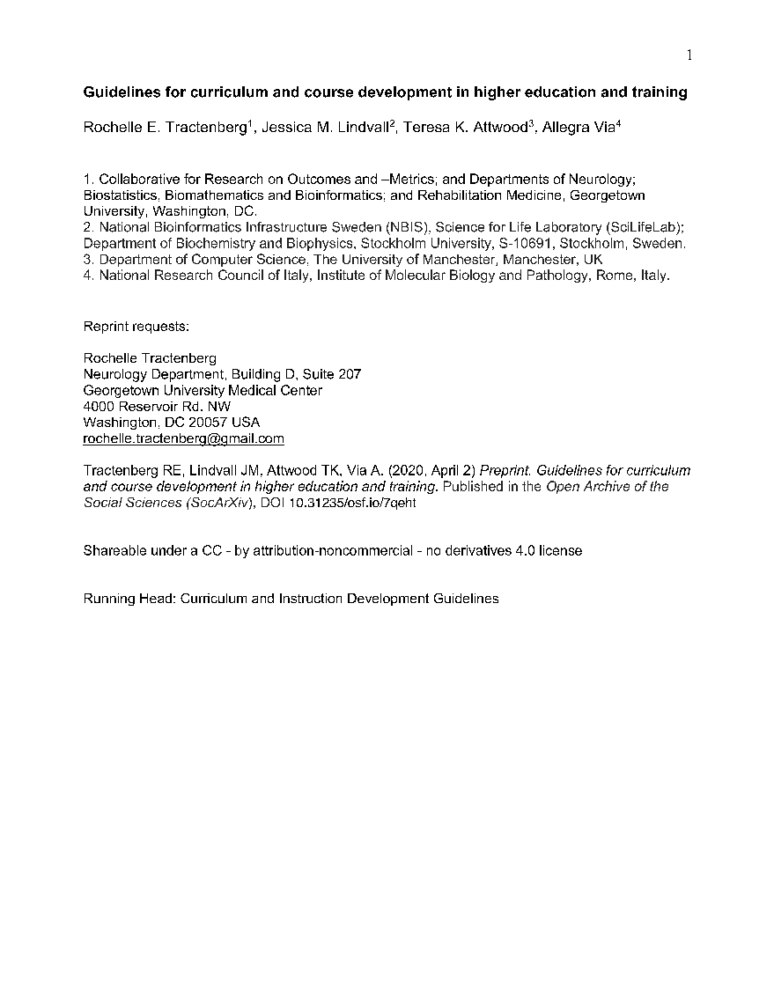
https://osf.io/preprints/socarxiv/7qeht/
https://doi.org/10.7490/f1000research.1118395.1
Notes:
You can find more details of our recommendations in the Guidelines for Curriculum & Course Development we made available as a preprint (SocArXiv) in 2020;
* we also released a more practical/hands-on version specifically for trainers in our ELIXIR-GOBLET Professional Guidelines collection, in the F1000R Bioinformatics Education & Training Collection. In addition to 2 Professional Guidelines with regards to the framework itself as said earlier

Slide 24
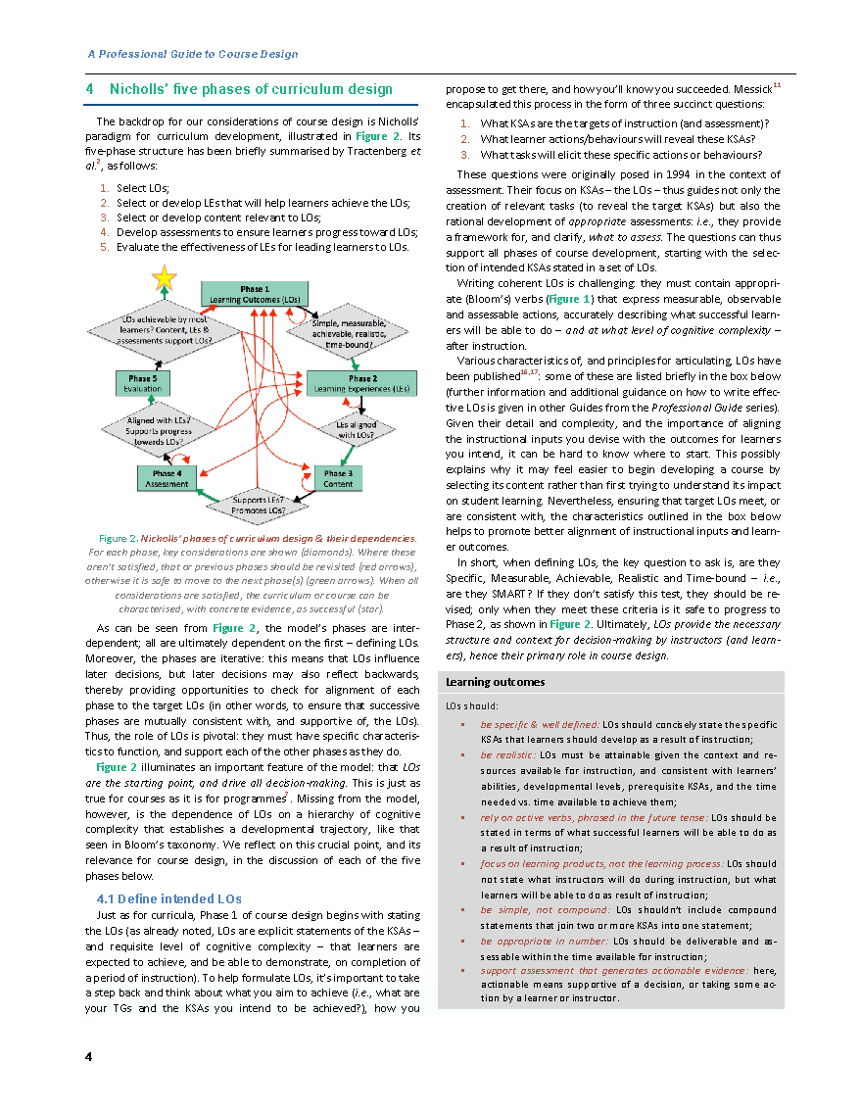
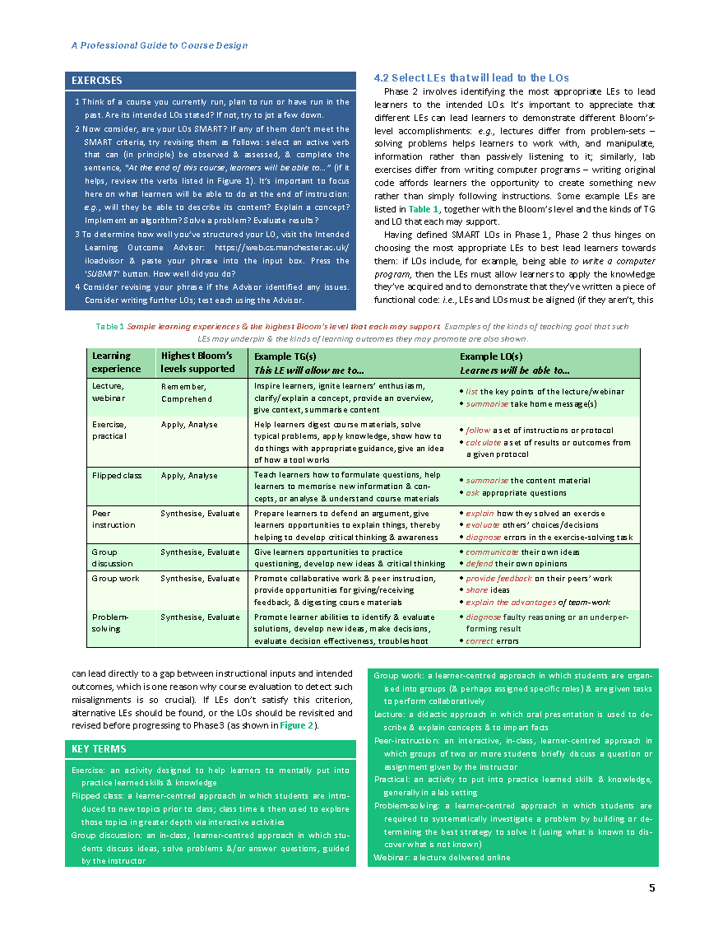
Notes:
In those documents, you’ll see that we use Nicholls’ 5-phase paradigm for curriculum/course design as an exemplar, which is illustrated here in the diagram on the left.

Slide 25
Nicholls’ Model
Phase 1
Learning Outcomes (LOs)
LOs achievable by most learners? Content, LEs & assessments support LOs?
Simple, measurable, achievable, realistic, time-bound?
Phase 5
Evaluation
Phase 2
Learning Experiences (LEs)
Aligned with LEs?
Supports progress towards LOs?
LEs aligned with LOs?
Phase 4
Assessment
Phase 3
Content
Supports LEs?
Promotes LOs?
Notes:
Details of the model aren’t important here.
The point is, there are 5 key phases in the course-design process: from defining LOs, to selecting LEs, to selecting content, devising appropriate assessments to course evaluation.
* At each phase there are decision points to test whether specific criteria have been met (e.g., are the LOs SMART…);
* If the criteria haven’t been met, either that phase requires revision, the previous phase needs revision or Phase 1 needs revision. Only after this iterative cycle of revision & refinement at each step can the process be regarded as complete.
The crucial take-home here is that, Phase 1 is the first-class citizen of the design process, because each phase must be congruent with it – & Phase 1 is articulating LOs!

Slide 26
Start by articulating learning outcomes
Phase 1
Learning Outcomes (LOs)
LOs achievable by most learners? Content, LEs & assessments support LOs?
Simple, measurable, achievable, realistic, time-bound?
Phase 5
Evaluation
Phase 2
Learning Experiences (LEs)
Aligned with LEs?
Supports progress towards LOs?
LEs aligned with LOs?
Phase 4
Assessment
Phase 3
Content
Statements detailing what students will be able to do & the teacher will be able to assess
Supports LEs?
Promotes LOs?
Notes:
So, we start the course-design process by articulating the intended learning outcomes.
These are statements that detail what students will be able to do & the teacher will be able to assess by the end of the course.

Slide 27
Learning outcomes
are phrased actively
By the end of this course, students will be able to:
EXPERIMENTAL DESIGN
HYPOTHESIS GENERATION
IDENTIFY RELEVANT DATA
Correctly uses data that are provided or can follow a x script/‘recipe‘ to obtain (access, manage) relevant data to which they are guided. x Can‘t determine whether a given data-set or...
Can identify salient features of experiments that are described/given if they match previously encountered design elements, but can‘t derive them if they‘re not present...
Uses given methods, as directed, & learning about x the concepts of pipelines & workflows; still uses workflows as if they are pipelines, but beginning to x attend to decision points...
When directed, uses the default settings of software, tools, or the GUI, to test hypotheses in pre- planned analyses; doesn‘t generate testable hypotheses. Doesn‘t recognise that...
IDENTIFY & USE APPROPRIATE METHODS
DEFINE A LITERATURE-BASED PROBLEM
Interpretation of results depends on p-values, but understanding of p-values is incomplete. Learn- ing to recognise that interpretation of output critically depends on x methods used & the...
Developing awareness of the depth & breadth of the knowledge-base that is or could be relevant for the formulation of a problem. Can‘t differentiate gaps in own knowledge from gaps in…
INTERPRETATION OF RESULTS
INTEGRATE INTERDISCIPLINARITY
Learning fundamentals of how appropriate conclusions are drawn from results, but may not be able to draw those conclusions from given results themselves. Learning to differentiate between...
Beginning to think about life sciences as requiring inte- gration of both experimental & computational/ modelling approaches. Recognises that interdisciplinarity is needed, ...
DRAW & CONTEXTUALISE CONCLUSIONS
PK COMPUTATIONAL METHODS
Learning to recognise the value of clear communication & about the role of communication in sharing & x publishing research, data, code, data management, tools &...
LO3: list popular databases & protein sequence/3D structure analysis tools
Computers, software, tools & programming are under- stood to be options for scientific work. Learning how to write & test code, run software, or use tools, as appropriate. Is developing...
Advanced knowledge of biology, & basic knowledge of key bioinformatics methods. Very simple statistics/programs are run to answer pre-defined scientific questions. Learning to understand…
Consolidates reading & understanding, beginning to learn how to apply software to given bio- logy problems. Growing recognition that ‘facts‘ are...
Consolidates reading & understanding, beginning to learn how to apply software to given bio- logy problems. Growing recognition that ‘facts‘ are...
Learning to recognise ‘misconduct’ in the scientific sense. Learning to avoid, & respond to, mis- conduct; & the importance of neither condoning nor promoting it.
COMMUNICATION
LO4: search databases using BLAST or other software tools
PK BIOLOGY
Understand, apply
ETHICAL PRACTICE
Late undergraduate, early Masters
LO1: explain the Central Dogma
BEGINNER
LO2: describe the challenges of gene prediction in terms of gene structure
Notes:
LOs are phrased actively, articulating what students will be able to do:
* e.g., “by the end of this course, students will be able to:…”
* For this course or module, appropriate Beginner-level (understand, apply)
* LOs for Biology might be, “by the end of the course, students will be able to
* explain the Central Dogma…” or “describe the challenges of gene prediction in terms of gene structure.”
* For Computational methods, appropriate Beginner-level LOs might be, “by the end of the course, students will be able to
* list popular databases & protein sequence & structure analysis tools,” or
* “search databases using BLAST or other bespoke software tools.”

Slide 28
By the end of this course, students will be able to:
LO5: apply fingerprint & HMM search tools to identify the family to which protein sequences belong
EXPERIMENTAL DESIGN
HYPOTHESIS GENERATION
IDENTIFY RELEVANT DATA
Can initiate a search for data & will ask if uncertain about the relevance for any given problem. Learning how to identify, & evaluate strengths & weaknesses of, data resources, to...
Can match the correct data-collection design to the instruments & outcomes of interest. May include/exclude covariates, or other design features, because that is...
Can identify methods, software & pipelines that x are relevant for a given problem; seeks guidance about the best approach. Learning to evaluate/rank & justify alternative methods in...
With guidance, can: 1) leverage tools, software, data & other technologies (GUI/programming) to test hypotheses; & 2) generate hypotheses based on either the data or the technology...
IDENTIFY & USE APPROPRIATE METHODS
LO6: analyse search outputs to determine the biological significance of results
DEFINE A LITERATURE-BASED PROBLEM
Seeks guidance to interpret results/output, including considerations of alignment of methods & results. Understands that the p- value represents evidence about the null hypothesis...
Beginning to use, with guidance, the appropriate knowledge base to address a given problem. Recognises the need to consider a wider scope of knowledge for alternative solutions…
INTERPRETATION OF RESULTS
INTEGRATE INTERDISCIPLINARITY
With guidance, can draw conclusions in own work that are coherent with the research hypothesis/ hypotheses & across the entire manuscript/writeup (as appropriate)...
Understands that life sciences integrate experimental & computational/modelling approaches; seeks guidance about how & when to integrate. Developing an understanding of…
DRAW & CONTEXTUALISE CONCLUSIONS
LO7: synthesise results from different analyses to draw preliminary conclusions about the likely functions of protein sequences
PK COMPUTATIONAL METHODS
Understands the roles of sharing & publishing research, data, code, data management, tools & resources in x scientific communication. Seeks guidance so that own communication is...
Learning to test software & programming approaches to different types of problem. Experimental design
& statistical inference using computing & algorithms are recognised & applied...
Reads & understands; reliably identifies methods (soft- -ware & programming) for given problems. Chooses & executes correct analysis, not necessarily able to...
Thinking about life sciences integrates experimental & bioinformatics/technological sources for data & knowledge. Understands the uncertainty inherent in the scientific method, questions assumptions...
Reads & understands; reliably identifies methods (soft- -ware & programming) for given problems. Chooses & executes correct analysis, not necessarily able to...
Learning the principles of ethical professional & scientific conduct. Seeks guidance to strengthen applications of these principles in own practice. Learning how to respond to unethical practice.
COMMUNICATION
PK BIOLOGY
Apply, analyse, synthesise
LO8: present results to a lay audience
ETHICAL PRACTICE
Late Masters, early PhD
APPRENTICE
Notes:
* Appropriate Apprentice-level (apply, analyse, sythesise) LOs for
* Identify and use appropriate methods might be that, “by the end of the course, students will be able to apply fingerprint and HMM tools to identify the family to which protein sequences belong”,
* For Interpretation of results, “by the end of the course, students will be able to analyse search outputs to determine the biological significance of results”,
* For Draw conclusions, “by the end of the course, students will be able to sythesise results from different analyses to draw preliminary conclusions about the likely functions of protein sequences”
* and for Communication, “by the end of the course, students will be able to present results to a lay audience.”
Note that these are all active behaviours, at the requisite Blooms level, that a teacher will, in principle, be able to assess. The examples are clearly just fabricated, but hopefully show how LOs can be informed by the relevant KSA & PLDs at each stage. Again, the PLDs are not meant to be taken literally, but rather to be used as guides towards what might be appropriate behaviours & outcomes at given developmental stages. And that really is it.

Slide 29
CONCLUSIONS
The MR-Bi provides a standard framework for developing scientific & discipline-specific KSAs, from less to more expert (following the Bloom’s structure of critical thinking)
Its structure allows it to be adapted to any discipline, specifically related to Bioinformatics, simply by changing its discipline-specific KSAs
It’s a multi-layered tool with applications in professional development & course design
It’s not as scary as it looks – why not try it?!
Notes:
To conclude…
* The MR-Bi provides a standard framework for developing scientific & discipline-specific KSAs, from less to more expert (following the Bloom’s structure of critical thinking)
* Its structure allows it to be adapted to any discipline, specifically related to Bioinformatics, simply by changing its discipline-specific KSAs
* It’s a multi-layered tool with applications in professional development & course design
* It’s not as scary as it looks – why not try it?!

Slide 30
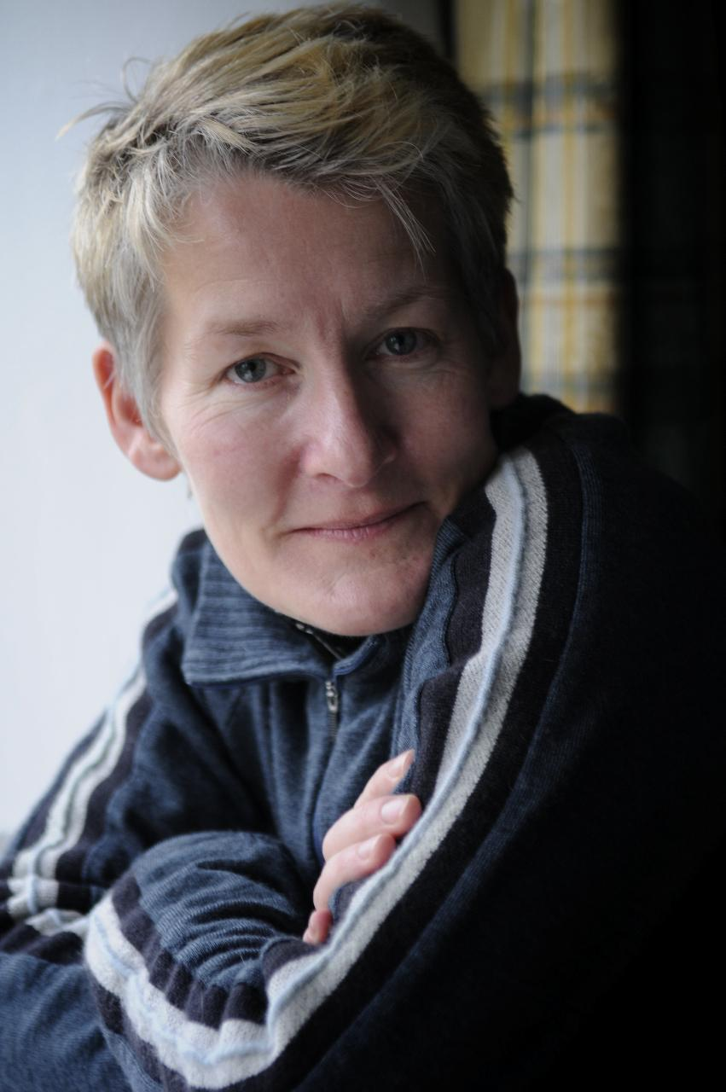
ACKNOWLEDGEMENTS
Rochelle Tractenberg, Allegra Via, Terri Attwood, Patricia Palagi
Notes:
Before ending, with the last slide being the resource s, I’d like to acknowledge the rest of the MR-Bi & ELIXIR-GOBLET Professional Guidelines team: RT, AV, TA and PP

Slide 31
Resources
the presentation builds on
MR-Bi paper, PLoS ONE: https://doi.org/10.1371/journal.pone.0225256
Curriculum Guidelines, SocArXiv: https://osf.io/preprints/socarxiv/7qeht/
Curriculum Guidelines, F1000R: https://doi.org/10.7490/f1000research.1118395.1
Introducing the MR-Bi, F1000: https://doi.org/10.7490/f1000research.1119019.1
Using the MR-Bi, F1000R: https://doi.org/10.7490/f1000research.1119023.1
MR-Bi slides - training and professional development: https://doi.org/10.17044/scilifelab.16715374.v1
Notes:
A re-cap of the resources used in the presentation and for you to have a look at if interested. Also if you have any questions later or like to get in contact with me or anyone in the team, please email me, jessica.lindvall@scilifelab.se

